Slide 1

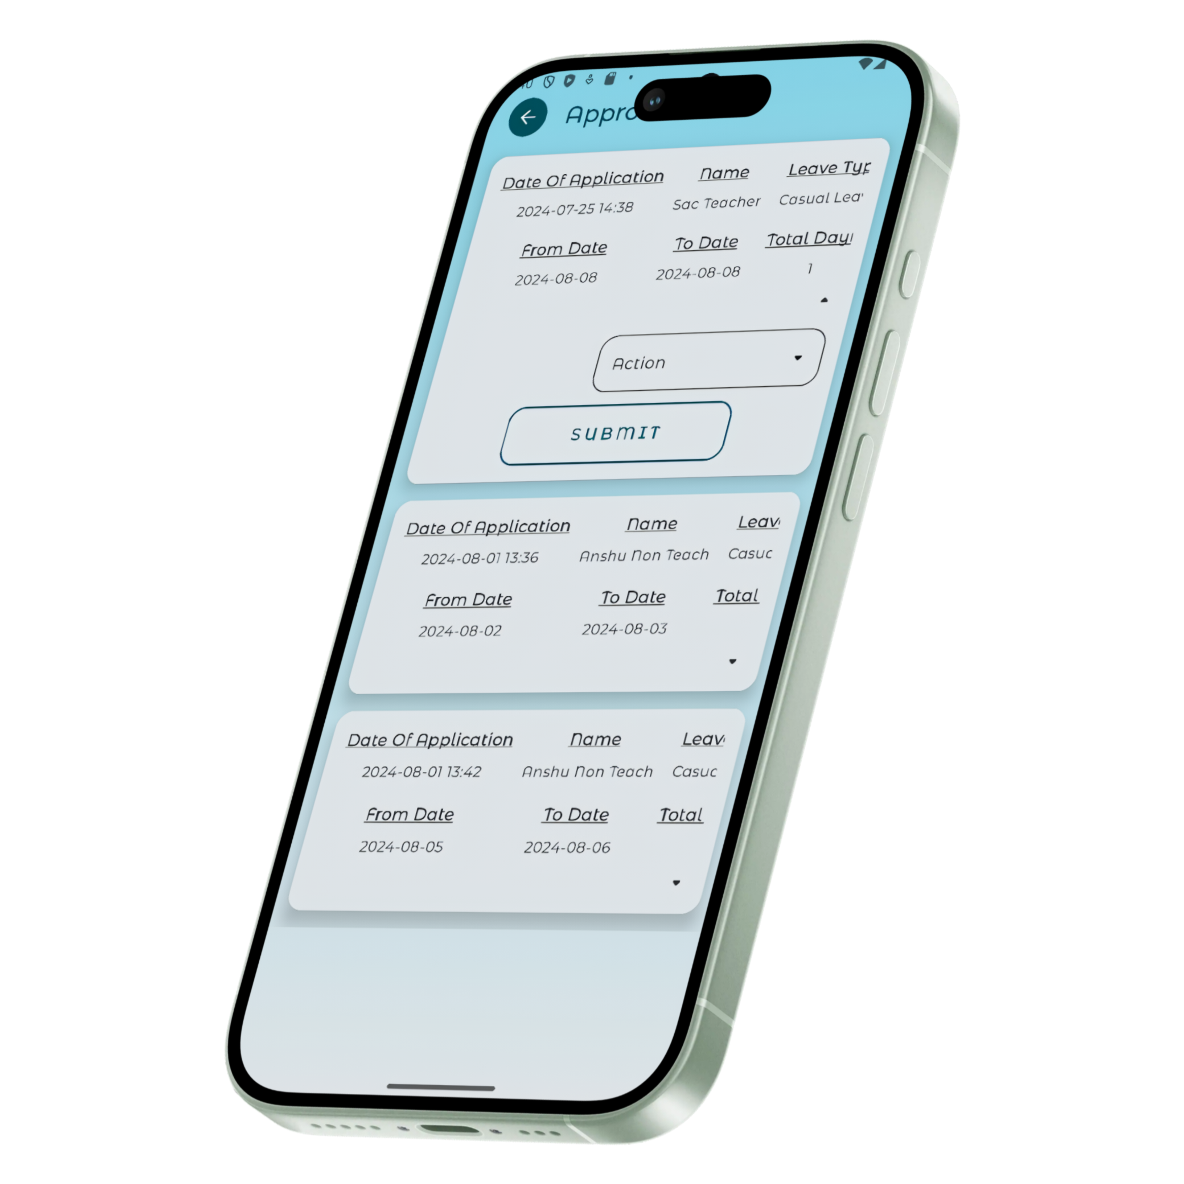
Leave Management System

Slide 2
Over view
Problem Statement
Process Model
Data Flow Diagram
ER Diagram
Functional Point Calculation
Basic Path Testing & Maintenance

Slide 3
Problem Statement
Limited Accessibility: The Existing software are web application which limit accessibility as user need to be near a computer to use the system.
Inflexibility: The existing software are to complex to use and not user friendly.
Lack of Automation: Existing Leave management systems lack in important features like managing leave balance and employees.
Lack of Record Management: The old software doesn’t have a refine record management as most record are saved on paper or poorly on database.

Slide 4
Process Model
Iterative Model

Slide 5
Iterative Model
In Iterative Model we start with some of the software specifications and develop the first version of the software.
After the first version if there is a need to change the software, then a new version of the software is created with a new iteration.
Every release of the Iterative Model finishes in an exact and fixed period that is called iteration.
Design
Design
Testing
Requirement
Testing
Analysis
Implementation
Design
Implementation
Review
Review
Implementation
Review
Testing
Maintenance

Slide 6
Reason For Choosing Iterative Model
Refinement: Each iteration are developed separately this allows development, Testing ,and deployment easy and end product is less error prone.
Flexibility: This model allows adding new feature easy as we can just add a new Iteration.
Paralla Development: Multiple Iteration can run at the same time as they are independent of each other.
Risk management: Risk identification and resolving is done for each iteration this makes risk management less complex and easy.

Slide 7
Data Flow Diagram
Data Flow Diagram (DFD) represents the flow of data within information systems. It provide a graphical representation of the data flow of a system can be understood by both technical and non-technical users.
Bellow is DFD of leave management system for client of authentication and authorization, applying and managing leave.

Slide 8
DFD Leave 0 (Context Diagram)
USER
The context diagram is the most basic representation of the system, showing the system as a whole and its interactions with external entities.
Leave management System Client
Authentication & Authorization
Leave
Management
Employee
Management
Admin
Manager
Admin

Slide 9
DFD Level 1
This shows more detailed view of data flow of the system by breaking it down into multiple sub module

Slide 10
USER
Authentication & Authorization
Leave Status Management
Admin
Employee
Details
Management
Leave Management
Employee
Management
Leave
Management

Slide 11
DFD Level 2
Level 2 goes a level further. It breaks the sub-modules into individual model and shows the data flow it them.
Bellow are the DFD levels of:
Authentication & Authorization
Employee Leave management
Admin Leave & Status management
Employee Management

Slide 12
User Authentication & Authorization
USER
Login Request
Verify
Employee Access
Verify Admin
Access
Upload Details Request

Slide 13
Employee Leave management
USER
View leave Balance
Request
Apply leave
Request
View leave
Request
Fill Details
View Leave balance Response
Validate Details
View Leave
Response
Leave Request Accepted
Notify Admin
Of Request

Slide 14
Admin Leave & Status management
ADMIN
View Report Request
Get Pending Leave Request
Get Leave Balance Request
View Leave Request
Download Report Request
Reject
Leave
Approve Leave
Edit Leave Balance
Report PDF
View leave
Response
Notify Employee
Update Leave Balance Request
Update
conformed

Slide 15
Admin Employee Management
ADMIN
Update Departmental In-charge
Add Employee Request
Remove Employee Request
Notify Old And New Employee
Give New department In charge
Admin Access
Notify Employee
Notify Employee
Revoke Admin Access From Old Department In-charge
Give Application Access
Revoke Application Access

Slide 16
Entity Relationship Diagram
The Entity Relational Diagram(ERD) is used for identifying entities in the database and the relationship between them.

Slide 17
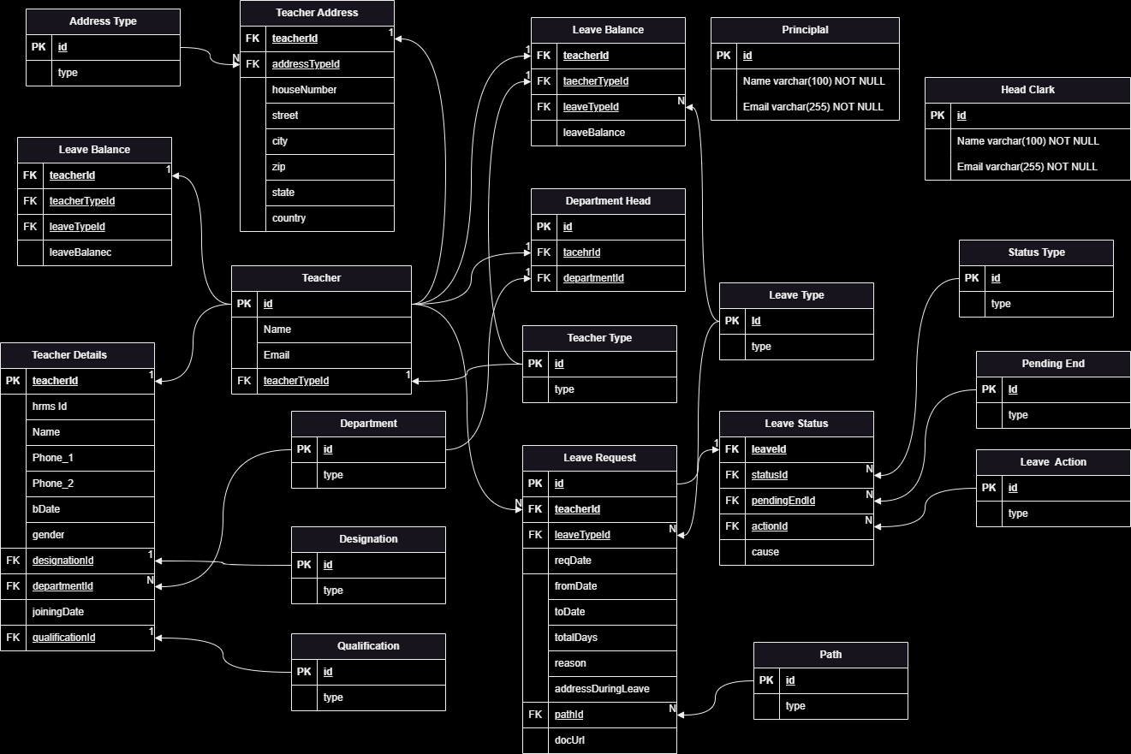
ER Diagram

Slide 18
Functional Point Calculation
It is a part of software development which helps to approximate the cost of development by using inputs, outputs, inquiries, internal files, and external interfaces.

Slide 19
Functional Unit | Wighting Factor
 | LOW | AVG | High
External Input(EL) | 3 | 4 | 6
External Output(EO) | 4 | 5 | 7
External Enquiry(EQ) | 3 | 4 | 6
Internal Logic Files(ILF) | 7 | 10 | 15
External Interface Files(EIF) | 5 | 7 | 10

Slide 20
Unadjusted Functional Point
Measurement Parameter | Avg x Count
External Input(EL) | 3 * 40 = 120
External Output(EO) | 3 * 20 = 60
External Enquiry(EQ) | 0 * 30 = 0
Internal Logic Files(ILF) | 3 * 30 = 90
External Interface Files(EIF) | 2 * 20 = 40
Complexity Adjustment factor- 3
Σli =14*3= 42
FP=total count*(0.65*0.01*Σli)
FP=310*(0.65+0.42)
FP=310*1.07
Total Count: 310
Functional Point: 331.7

Slide 21
Effort Calculation
To generate an effort calculation for the Leave Management System client project completed
over four months (May,June,July,Aug), we need to consider several factors such as total effort in hours, effort distribution across different activities, and resource allocation.

Slide 22
Activities and Estimated Effort
Distribution:
Requirements Gathering and Analysis: 10%
Design (including ERD, DFDs): 15%
Development (coding, implementation):
50%
Testing (unit testing, integration testing):
15%
Documentation and Deployment: 10%
Assumptions:
Working Days Per Month: 22
(approximately)
Working Hours Per Day: 8
Total Working Days Over Three Months: 22 days/month * 4 months = 88 days
Total Working Hours Over Three Months: 88 days * 8 hours/day = 704 hours

Slide 23
If we break down the effort calculation for each activity:
Requirements Gathering and Analysis:
Effort: 10% of 708 hours
Calculation: 708 * 0.10= 70.8 hours
Testing (unit testing, integration testing):
Effort: 15% of 708 hours
Calculation: 708 * 0.15 = 106.2hours
Design (including ERD,DFDs):
Effort: 15% of 708 hours
Calculation: 708 * 0.15 = 106.2 hours
Documentation and Deployment:
Effort: 10% of 708 hours
Calculation: 708 * 0.10 = 70.8 hours
Development (coding, implementation):
Effort: 50% of 708 hours
Calculation: 708 *0.50 = 345 hours

Slide 24
Effort Calculation Summery
May:
Total Working Hours: 176 hours (22 days * 8
hours/day)
Activities: Requirements Gathering and Analysis:
52.8 hours Design: 79.2 hours Development:
44 hours (partial)
Activity | Percentage | Hours
Requirement Gathering and Analysis | 10% | 70.2
Design (Including ERD,DFDs) | 15% | 106.2
Development (coding, implementation) | 50% | 345
Testing (unit testing, integration testing) | 10% | 70.2
Documentation and Deployment | 10% | 70.2
Total | 100% | 708
June:
Total Working Hours: 176 hours
(22 days * 8 hours/day)
Activities: Development: 176 hours (continuation)
July:
Total Working Hours: 176 hours
(22 days * 8 hours/day)
Activities: Development: 176 hours (continuation)
Aug:
Total Working Hours: 176 hours
(22 days * 8 hours/day)
Development: 44 hours (completion)
Testing: 79.2 hours
Documentation and Deployment: 52.8 hours

Slide 25
TimeLine Chart
To create a timeline chart for the Leave Management System client project, we can
use a Gantt chart style to illustrate the progress over the three months
(May,June,July,Aug). The Gantt chart will show the duration of each
activity and how they overlap.

Slide 26
Gant chart Timeline
Activities and Their Duration:
Requirements Gathering and Analysis: 1 week (May 1 - May 7)
Design (including ERD, DFDs): 2 weeks (May 8 - May 21)
Development (coding, implementation): 15 weeks (May 22 - July 25)
Testing (unit testing, integration testing): 2 weeks (July 26 - Aug 8)
Documentation and Deployment: 1 week (Aug 9 - Aug 15)

Slide 27
May
June
July
Aug
1
7
Requirement
Gathering
And Analysis
21
8
Design
22
25
Development
26
8
Testing
Documentation
Deployment

Slide 28
Thank You

